Slide 1
Presentation of the association
SCS
Slovenian Cleanroom Society
Slovenian Cleanroom Society

Slide 2
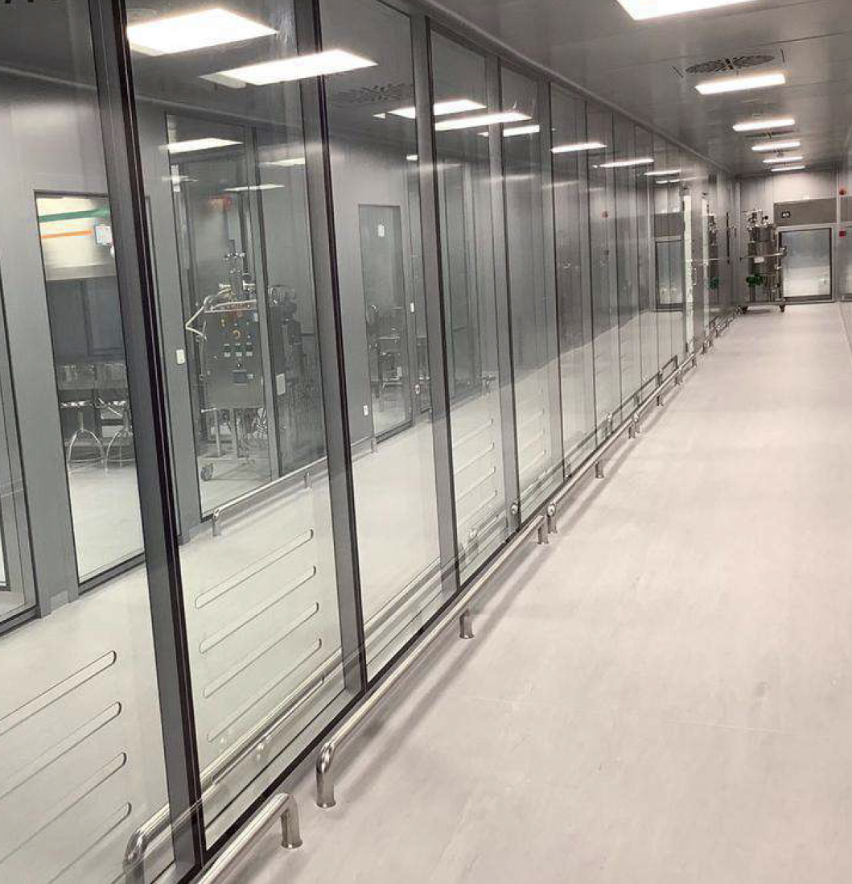
Goals of SCS: (1/2)
Represent Cleanroom and contamination control users and professionals in Slovenia, following the principles of Not for Profit, Non-partisan and open to all.
Support and develop the Cleanroom and contamination control industry in Slovenia.
Organize and support seminars, exhibitions, and similar events to disseminate knowledge and share experiences in Cleanroom and contamination control.
Raise awareness and act as a bridge between the public, educational institutions, and government in Cleanroom and contamination control activities.

Slide 3
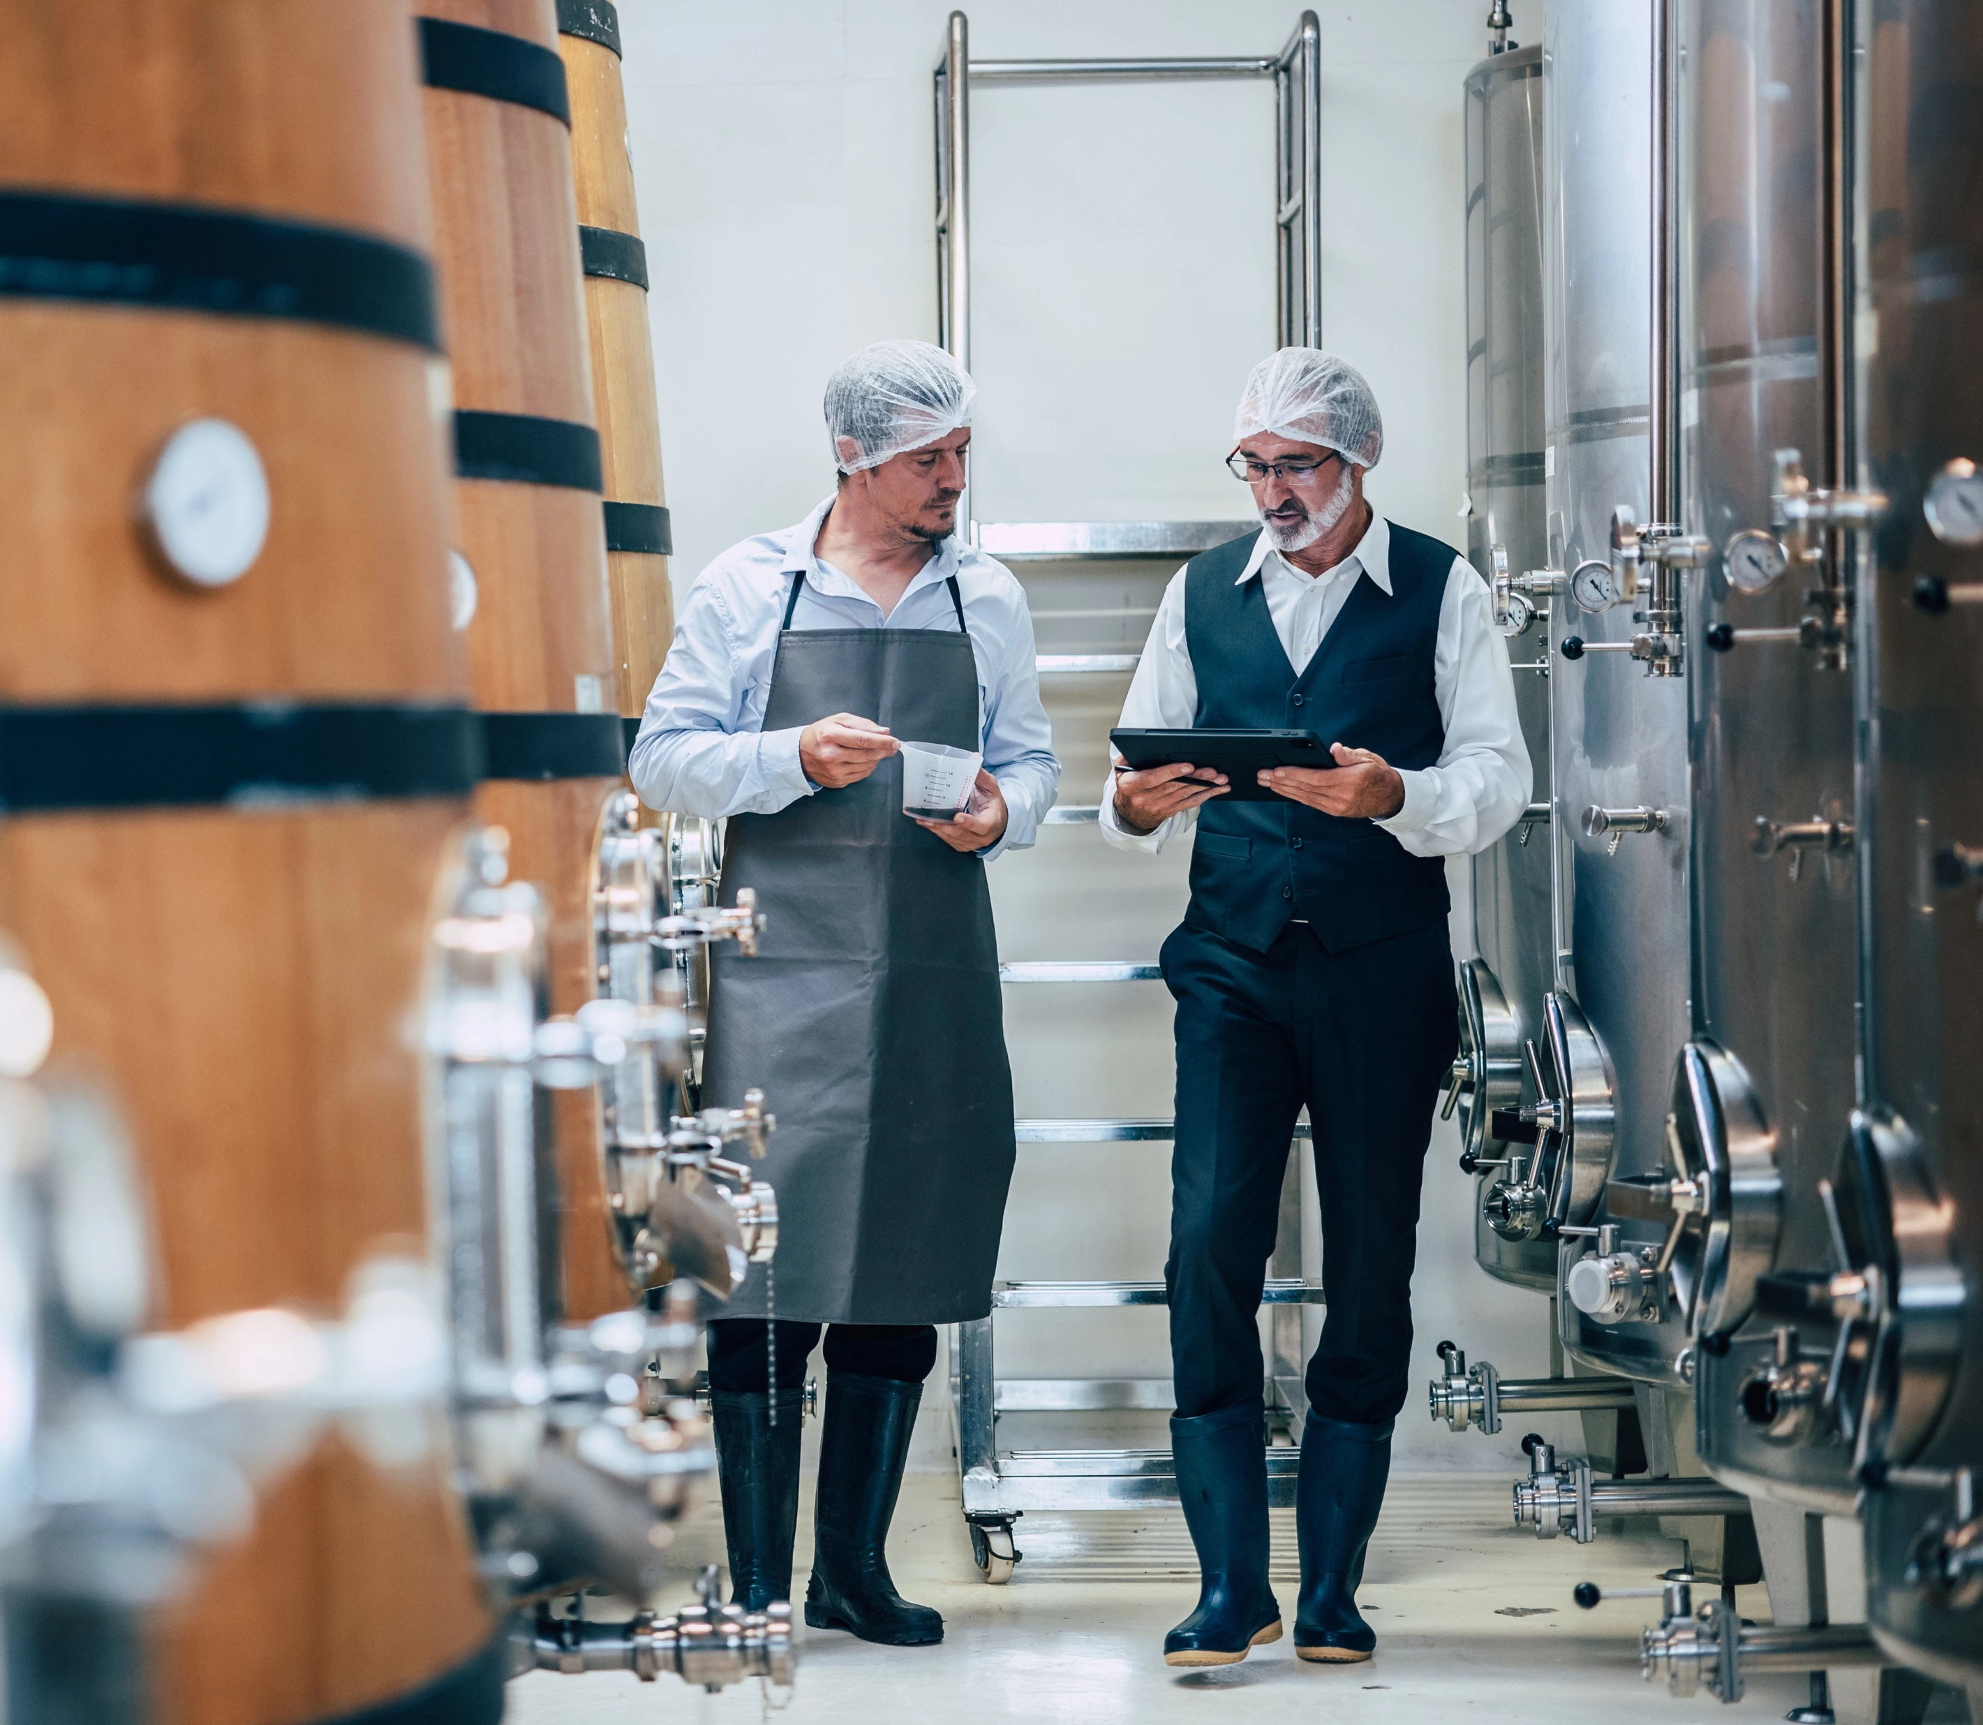
Goals of SCS: (2/2)
Represent Slovenia as a member of the ICCCS and support other international member societies in a spirit of openness and collaboration.
Provide support for the development of Cleanroom and contamination control technologies in Slovenia, on behalf of the Slovenian national standards body, SIS.
Represent SIS at CEN and ISO in the development of standards for Cleanroom and contamination control technologies and applications.

Slide 4
The primary tasks
Promote the common interests of its members at both local and international levels.
Collect and study laws and regulations related to cleanroom technology, keeping members informed of relevant updates.
Facilitate dialogue with government authorities responsible for regulating and enforcing cleanroom technology and contamination control.
Raise public awareness of the Association’s activities and its role in the development of medical devices.
Organize symposiums, seminars, exhibitions, lectures, and other events to spread knowledge and experience in cleanroom technology and contamination control.
Promote education and training in cleanroom technology and contamination control.
Encourage research across all areas related to cleanroom technology and contamination control.
Participate in the development and monitoring of standards, guidelines, and best practices for contamination control and cleanroom technology.
Collaborate with related foreign associations and organizations to further enhance expertise and standards in the field.

Slide 5
SCS's Membership in the International Confederation of Contamination Control Societies (ICCCS)
Membership
Future Collaboration
The Slovenian Cleanroom Society (SCS) is a full member of the International Confederation of Contamination Control Societies (ICCCS).
By joining ICCCS, SCS looks forward to collaborating on international standards, sharing best practices, and contributing to global advancements in contamination control.

Slide 6
SCS Goals in the Field of Education:
Standardization
Harmonization of education and training for cleanrooms in accordance with the ISO TC209 standard (14644 and 14698).
Certification
Implementation of the fundamental principle of professional certification through examinations.
Education
Promotion of international education in the field of cleanroom technology and contamination control.
Collaboration
Encouragement of international cooperation and course exchange:
Among national cleanroom associations.
Between cleanroom users and experts.

Slide 7
Current SCS Members
Corporate Members:
Lek d.d. (Sandoz), info@sandoz.com, www.lek.si
Novartis d.o.o., info.slo@novartis.com, www.novartis.com
Iskra Pio d.o.o., info@iskra-pio.si, www.iskra-pio.si
Camfil Slovenia d.o.o., dejan.savsek@camfil.com, www.camfil.com
Messer Slovenija d.o.o., info.si@messergroup.com, www.messer.si
Klimer Štirn d.n.o., info@klimer.si, www.klimer.si
NKM d.o.o., info@nkm.si, www.nkm.si
Lonstroff d.o.o., info@lonstroff.com, www.lonstroff.com
TRM Filter d.o.o., info@trm-filter.com, www.trm-filter.com
NAYA LIFE SCIENCES d.o.o., contact@naya-ls.com, www.naya-ls.com
Bossplast d.o.o., info@bossplast.com, www.bossplast.com
Associate Member:
University of Ljubljana, Prof. Dr. Uroš Stritih, dekanat@fs.uni-lj.si, www.uni-lj.si

Slide 8
Executive board of Slovenian Cleanroom Society:
President: Aleš Bogataj, NOVARTIS d.o.o.
Vice presidents: Nataša Štirn, Klimer Štirn d.n.o.
Milan Morato, Iskra PIO d.o.o. ,
Members of the executive board: Luka Useničnik, Lek d.d. (Sandoz) Tine Teodorović, NKM d.o.o.
Agnes Krmelj, Lonstroff d.o.o. Gregor Jeglič, Bossplast d.o.o

Slide 9
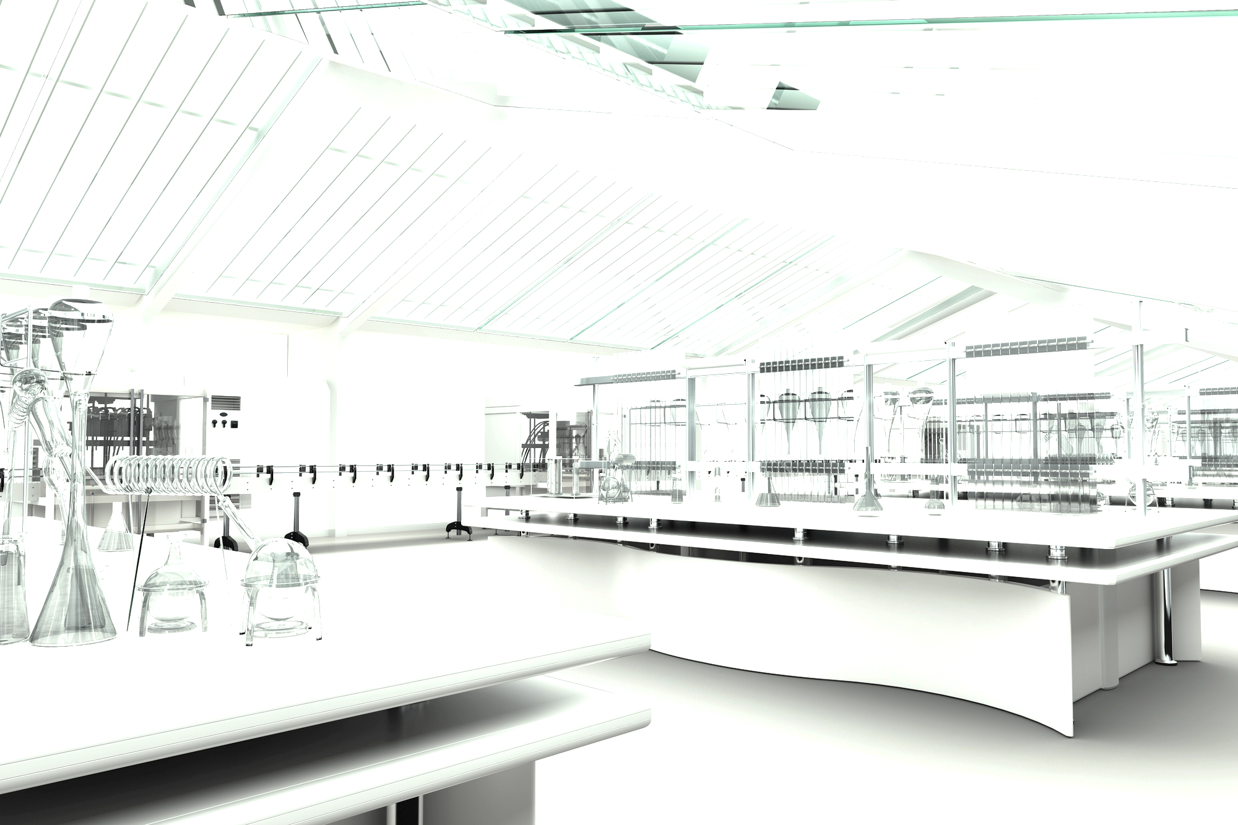
Slovenian Cleanroom Society
https://scs.gzs.si/
scs.slovenija@gzs.si
Chamber of Commerce and Industry Dimičeva 13 I Ljubljana I Slovenia

